Slide 1

VERBS
Ayu Pratiwi Ulfah, S.Hum., M.Hum.

Slide 2
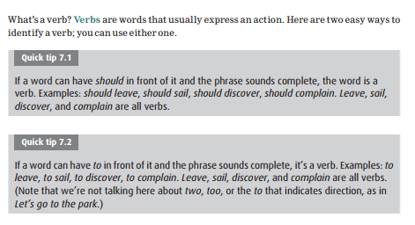
Identifying Verbs

Slide 3
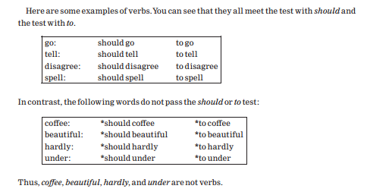

Slide 4
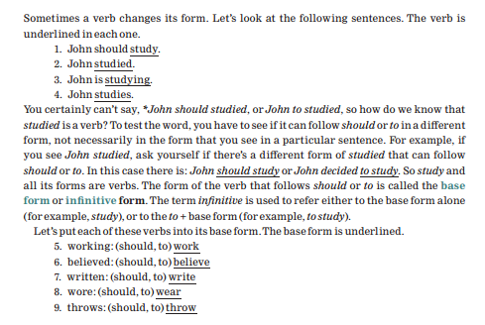
The verb base

Slide 5
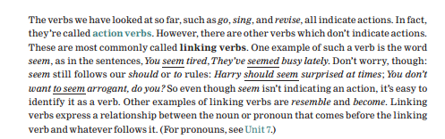
Action verbs and linking verbs

Slide 6
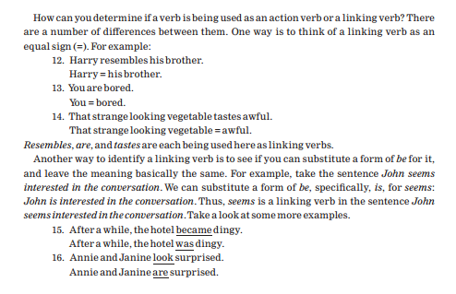

Slide 7
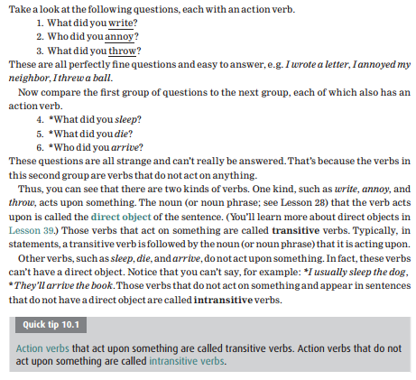
Transitive and intransitive verbs

